Slide 1
Unit 1 – Overview of OS (Additional)

Slide 2
Cloud Computing
Delivers computing, storage, even apps as a service across a network
Logical extension of virtualization because it uses virtualization as the base for it functionality.
Amazon EC2 has thousands of servers, millions of virtual machines, petabytes of storage available across the Internet, pay based on usage
Many types
Public cloud – available via Internet to anyone willing to pay
Private cloud – run by a company for the company’s own use
Hybrid cloud – includes both public and private cloud components
Software as a Service (SaaS) – one or more applications available via the Internet (i.e., word processor)
Platform as a Service (PaaS) – software stack ready for application use via the Internet (i.e., a database server)
Infrastructure as a Service (IaaS) – servers or storage available over Internet (i.e., storage available for backup use)

Slide 3
Cloud Computing (contd.)
Cloud computing environments composed of traditional OSes, plus VMMs, plus cloud management tools
Internet connectivity requires security like firewalls
Load balancers spread traffic across multiple applications

Slide 4
Real time Embedded System
Real-time embedded systems most prevalent form of computers
Vary considerable, special purpose, limited purpose OS, real-time OS
Use expanding
Many other special computing environments as well
Some have OSes, some perform tasks without an OS
Real-time OS has well-defined fixed time constraints
Processing must be done within constraint
Correct operation only if constraints met

Slide 5
OS Services
Operating systems provide an environment for execution of programs and services to programs and users
One set of operating-system services provides functions that are helpful to the user:
User interface - Almost all operating systems have a user interface (UI).
Varies between Command-Line (CLI), Graphics User Interface (GUI), Batch
Program execution - The system must be able to load a program into memory and to run that program, end execution, either normally or abnormally (indicating error)
I/O operations - A running program may require I/O, which may involve a file or an I/O device

Slide 6
OS Services (contd.)
One set of operating-system services provides functions that are helpful to the user (Cont.):
File-system manipulation - The file system is of particular interest. Programs need to read and write files and directories, create and delete them, search them, list file Information, permission management.
Communications – Processes may exchange information, on the same computer or between computers over a network
Communications may be via shared memory or through message passing (packets moved by the OS)
Error detection – OS needs to be constantly aware of possible errors
May occur in the CPU and memory hardware, in I/O devices, in user program
For each type of error, OS should take the appropriate action to ensure correct and consistent computing
Debugging facilities can greatly enhance the user’s and programmer’s abilities to efficiently use the system

Slide 7
OS Services (contd.)
Another set of OS functions exists for ensuring the efficient operation of the system itself via resource sharing
Resource allocation - When multiple users or multiple jobs running concurrently, resources must be allocated to each of them
Many types of resources - CPU cycles, main memory, file storage, I/O devices.
Accounting - To keep track of which users use how much and what kinds of computer resources
Protection and security - The owners of information stored in a multiuser or networked computer system may want to control use of that information, concurrent processes should not interfere with each other
Protection involves ensuring that all access to system resources is controlled
Security of the system from outsiders requires user authentication, extends to defending external I/O devices from invalid access attempts

Slide 8
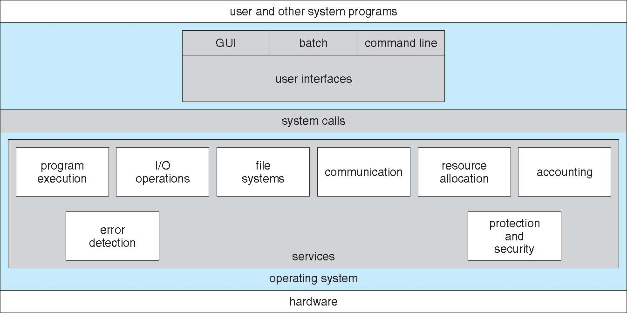
A view of OS Services (contd.)

Slide 9
System Calls
Programming interface to the services provided by the OS
Typically written in a high-level language (C or C++)
Mostly accessed by programs via a high-level Application Programming Interface (API) rather than direct system call use
Three most common APIs are Win32 API for Windows, POSIX API for POSIX-based systems (including virtually all versions of UNIX, Linux, and Mac OS X), and Java API for the Java virtual machine (JVM)

Slide 10
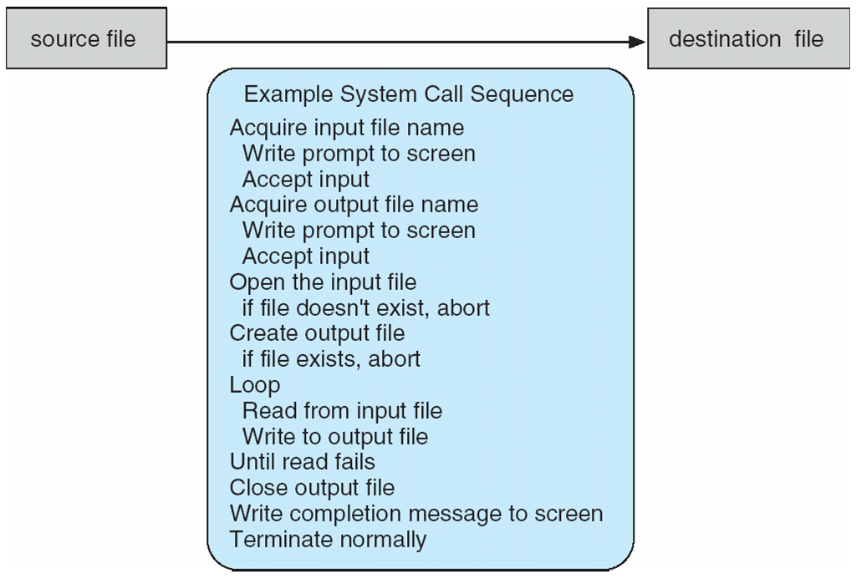
System Calls (contd.)
System call sequence to copy the contents of one file to another file

Slide 11
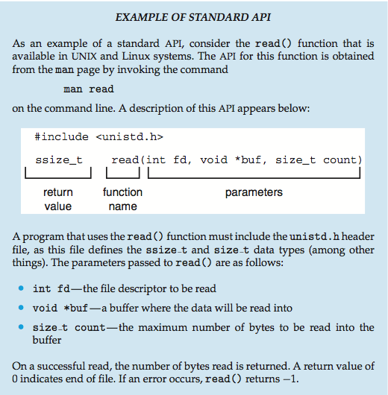
System Call (contd.)

Slide 12
System Call Implementation
Typically, a number associated with each system call
System-call interface maintains a table indexed according to these numbers
The system call interface invokes the intended system call in OS kernel and returns status of the system call and any return values
The caller need know nothing about how the system call is implemented
Just needs to obey API and understand what OS will do as a result call
Most details of OS interface hidden from programmer by API
Managed by run-time support library (set of functions built into libraries included with compiler)

Slide 13
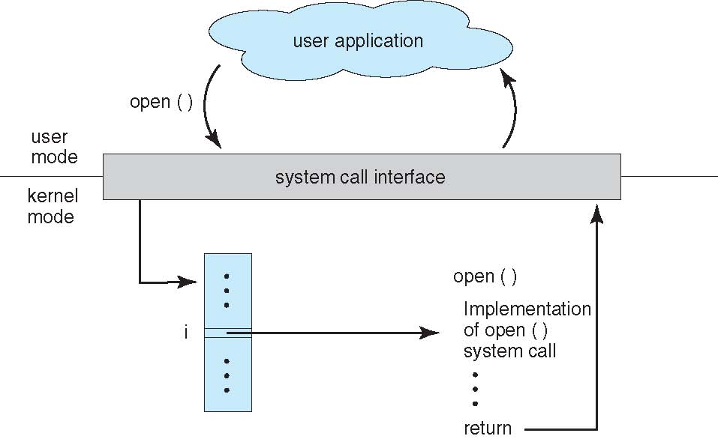
API – System Call – OS Relationship

Slide 14
Types of System Call
Process control
create process, terminate process
end, abort
load, execute
get process attributes, set process attributes
wait for time
wait event, signal event
allocate and free memory
Dump memory if error
Debugger for determining bugs, single step execution
Locks for managing access to shared data between processes

Slide 15
Types of System Call (contd.)
File management
create file, delete file
open, close file
read, write, reposition
get and set file attributes
Device management
request device, release device
read, write, reposition
get device attributes, set device attributes
logically attach or detach devices

Slide 16
Types of System Call (contd.)
Information maintenance
get time or date, set time or date
get system data, set system data
get and set process, file, or device attributes
Communications
create, delete communication connection
send, receive messages if message passing model to host name or process name
From client to server
Shared-memory model create and gain access to memory regions
transfer status information
attach and detach remote devices

Slide 17
Types of System Call (contd.)
Protection
Control access to resources
Get and set permissions
Allow and deny user access

Slide 18
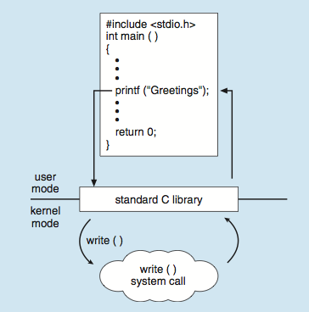
System Call (contd.)
C program invoking printf() library call, which calls write() system call

Slide 19
System Program
Provide a convenient environment for program development and execution
Some of them are simply user interfaces to system calls; others are considerably more complex
File management - Create, delete, copy, rename, print, dump, list, and generally manipulate files and directories
Status information
Some ask the system for info - date, time, amount of available memory, disk space, number of users
Others provide detailed performance, logging, and debugging information
Typically, these programs format and print the output to the terminal or other output devices
Some systems implement a registry - used to store and retrieve configuration information

Slide 20
System Program (contd.)
File modification
Text editors to create and modify files
Special commands to search contents of files or perform transformations of the text
Programming-language support - Compilers, assemblers, debuggers and interpreters sometimes provided
Program loading and execution- Absolute loaders, relocatable loaders, linkage editors, and overlay-loaders, debugging systems for higher-level and machine language
Communications - Provide the mechanism for creating virtual connections among processes, users, and computer systems
Allow users to send messages to one another’s screens, browse web pages, send electronic-mail messages, log in remotely, transfer files from one machine to another

Slide 21
System Program (contd.)
Background Services
Launch at boot time
Some for system startup, then terminate
Some from system boot to shutdown
Provide facilities like disk checking, process scheduling, error logging, printing
Run in user context not kernel context
Known as services, subsystems, daemons
Application programs
Don’t pertain to system
Run by users
Not typically considered part of OS
Launched by command line, mouse click, finger poke

